Slide 1
SHIFTING QUEUE
Introduction to Queues
Definition of a Queue (FIFO: First In, First Out).
Examples of real-life queues (ticket counters, bank lines, etc.).
Types of queues: Linear, Circular, Circular and Double-Ended Queues (Deque).
What is a Shifting Queue?
Definition: A queue where elements shift forward after dequeuing.
Works in a linear queue (array-based) method.
The front is reset to 0 after every dequeue.++

Slide 2
Shifting Queue Operation
Dequeue Operation
An element is removed from the queue
Remaining elements move forward to fill the gap
Elements Shift Forward
Front Reset to Zero
The front pointer is reset to the beginning

Slide 3
Pros of Queues:
Efficient Order Processing: Maintains a systematic way of handling tasks (e.g., printer queues, CPU scheduling).
Simple : Implementation: Easy to use and implement using arrays or linked lists .
Ensures Fairness: Every element gets processed in the order it arrives, preventing delays.
Memory Utilization (Circular Queues): Avoids wasted space by reusing empty slots.
Versatile Use Cases: Used in operating systems, networking (data packet handling), and real-time processing systems.

Slide 4
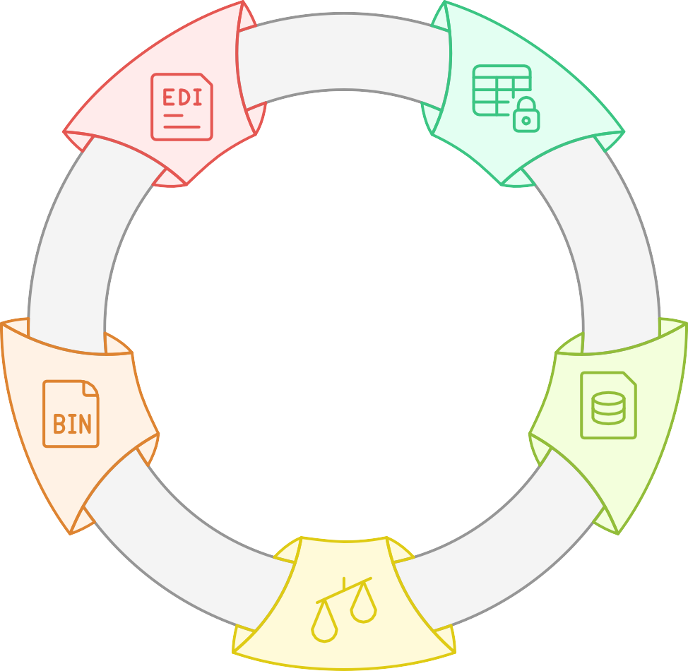
Advantages of Queues
Versatile Use
Cases
Applied in various systems like OS and
networking
Efficient Order Processing
Ensures systematic task handling
Memory Utilization
Reuses empty slots to avoid waste
Simple Implementation
Easy to use with arrays or linked lists
Ensures Fairness
Processes elements in arrival order

Slide 5
Problems with Shifting Queue
Time Complexity: Shifting elements takes O(n) time after each dequeue.
Performance Issues: Not efficient for large-scale data handling.
Wastage of Computation: Frequent shifting slows down operations.

Slide 6
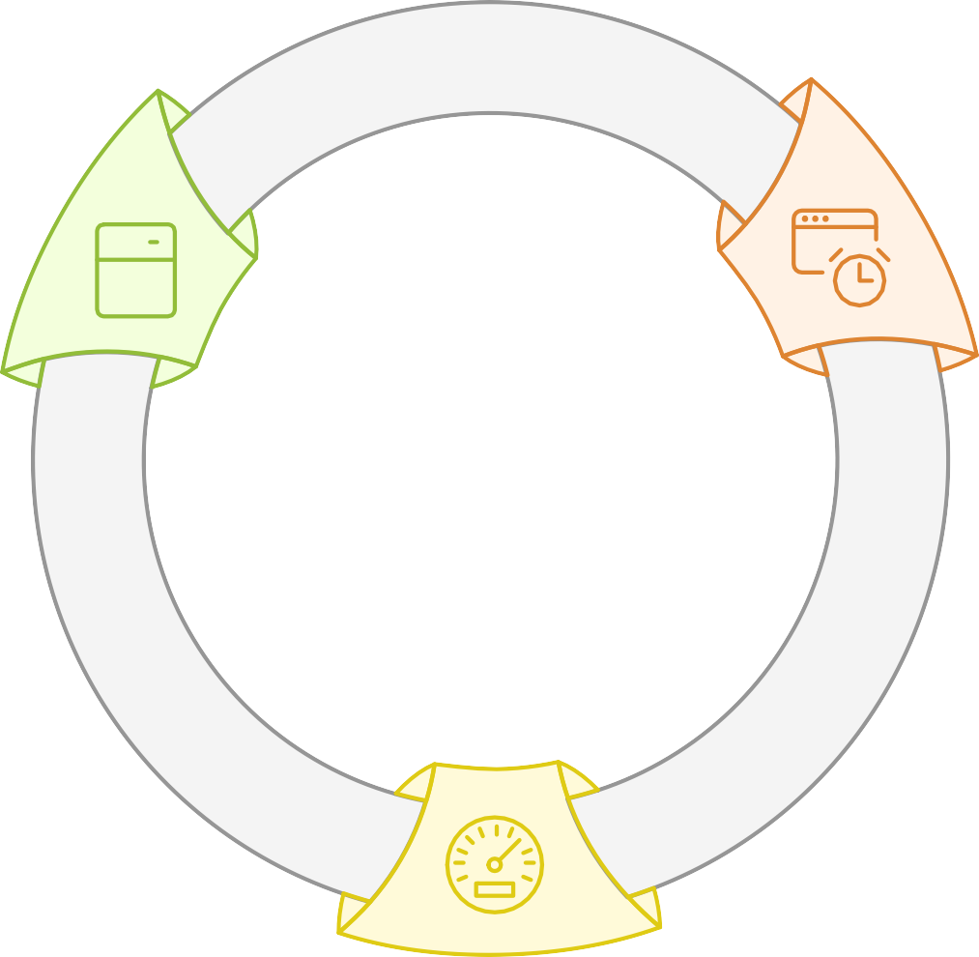
Challenges of Shifting Queue
Computation
Wastage
Frequent shifting slows down operations
Time Complexity
Shifting elements takes O(n) time after each dequeue
Performance Issues
Not efficient for large-scale data handling

Slide 7


Queue Movement Scenarios
Checkout Line
Train or Bus Queue
Cafeteria Line
Describes movement in a store queue.
Details how customers move in a food line.
Explains how passengers board and move.

Slide 8




Alternative to Shifting Queue
Circular Queue: Avoids shifting by wrapping around (rear = (rear + 1) % size).
Linked List Queue: Avoids shifting by using dynamic memory allocation.
Choose the optimal queue implementation to avoid shifting.
Circular Queue
Efficient space utilization
Linked List Queue
Flexible memory allocation

Slide 9
Conclusion
Shifting Queue is simple but inefficient due to the shifting process.
Better alternatives like Circular Queue and Linked List Queue improve efficiency.

